Slide 1
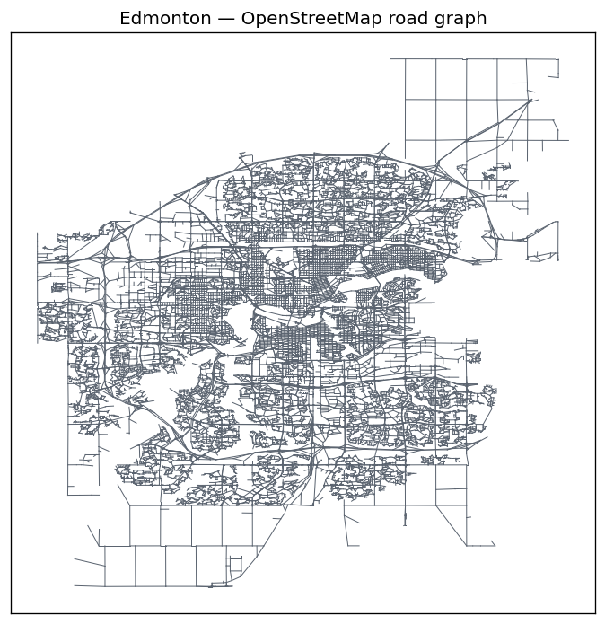
RideIQ
From an idea to a live, self-deploying ride-hailing app
Android app · ML backend · Docker · CI/CD · Cloud deployment
A student's guide to how it was built
Notes:
Welcome. RideIQ is a from-scratch, self-hosted ride-hailing app. Today we'll walk through how it was built, in order, and the big ideas: APIs, Docker, CI/CD, blue-green deployment, and live navigation.

Slide 2
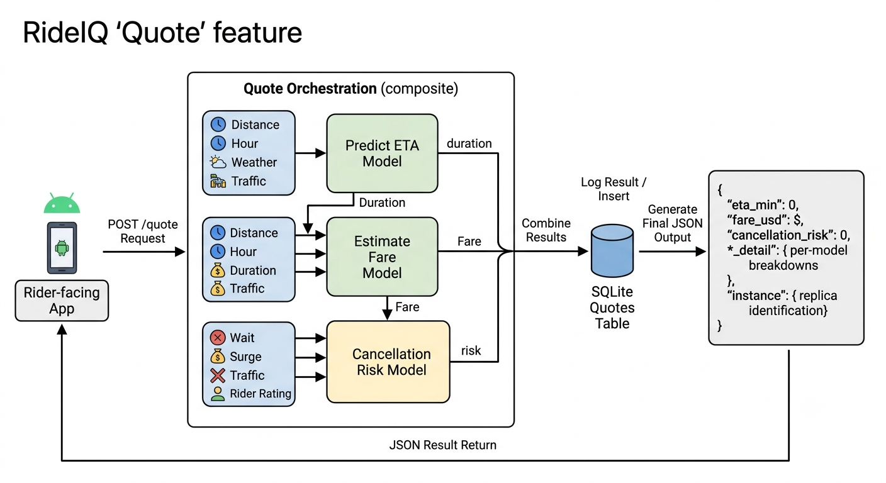
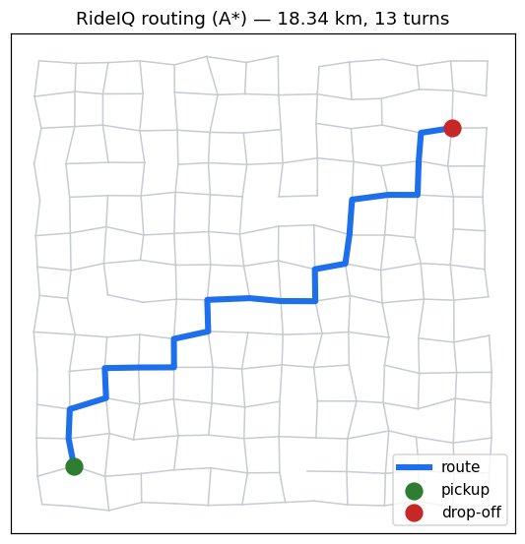
THE PRODUCT
What is RideIQ?
A simplified Uber. Set a pickup and a drop-off on a map of Edmonton and get a live route, an ETA, a fare, and turn-by-turn voice navigation.
Smart pricing 15 ML models predict ETA, fare and cancellation risk.
1
Own routing A* finds the road route over real Edmonton streets.
2
One /quote call returns ETA + fare + cancellation risk together.
Voice navigation Turn-by-turn directions spoken aloud, like Google Maps.
3
A routed trip on the map.
No paid APIs Free OpenStreetMap maps - no Google key, no billing.
4
Notes:
RideIQ looks like Uber but every piece is built from scratch and self-hosted. The right shows the quote feature and a routed trip. Crucially: no paid map APIs.

Slide 3
ROADMAP
What you'll understand by the end
1
How an app and a server talk
2
Why we 'box up' the app
The request that flows from phone to backend and back.
Docker containers and why they matter.
3
What CI/CD really means
4
Zero-downtime deploys
One push -> built and shipped automatically.
Blue-green + a one-click rollback safety net.
5
How live navigation works
6
Why each technology
GPS following + spoken turn-by-turn directions.
The choices behind FastAPI, osmdroid, nginx and more.
Notes:
Here's our roadmap. Each of these maps to a stage in how the app was actually built.

Slide 4
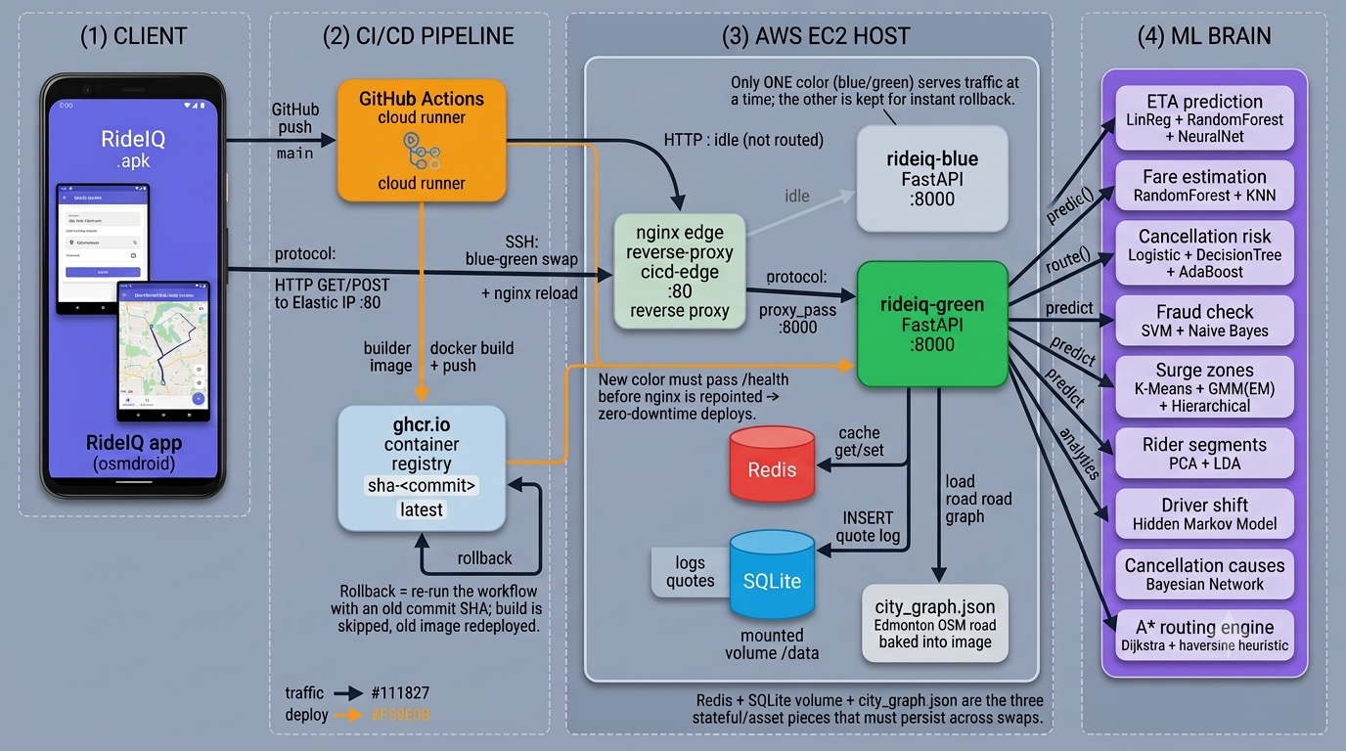
BIG PICTURE
The whole system at a glance
Client (phone) -> CI/CD pipeline -> AWS EC2 host (nginx + app + Redis + database) -> the ML brain
Notes:
Don't worry about every box yet. Left: the phone. Middle: the automated pipeline. Right: the cloud server running the app, with the ML brain inside. We'll unpack each part.

Slide 5
THE JOURNEY
How it was built - in order
1
2
3
4
Backend brain
(FastAPI + ML)
Package it
(Docker)
Android app
(map + quote)
Connect
app <-> backend
5
6
7
8
Put it online
(AWS EC2)
Automate
(CI/CD)
Zero-downtime
(blue-green)
Grow features
one by one
Build one thing, make it work, then add the next - the single most important habit in the project.
Notes:
This is the whole story on one slide. Blue = getting it running; gold = making it professional and growing it. We follow this order for the rest of the talk.

Slide 6
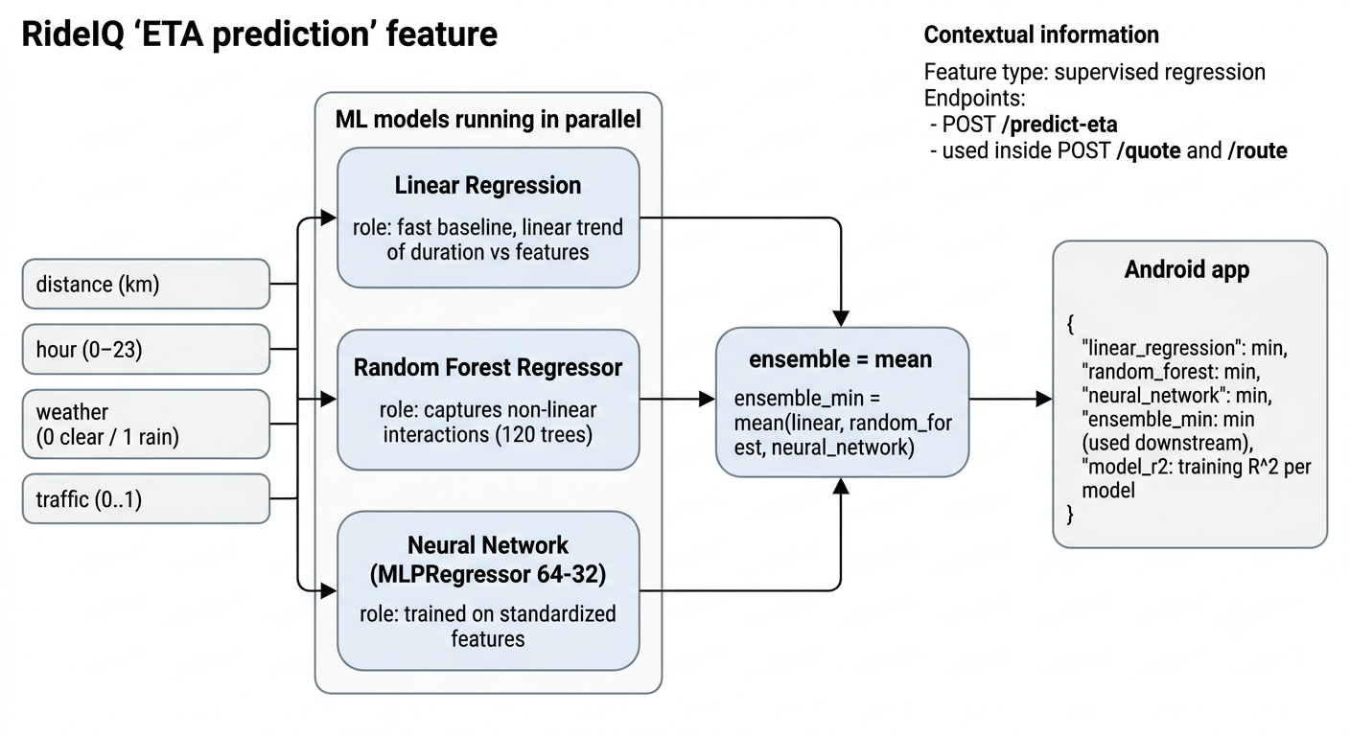
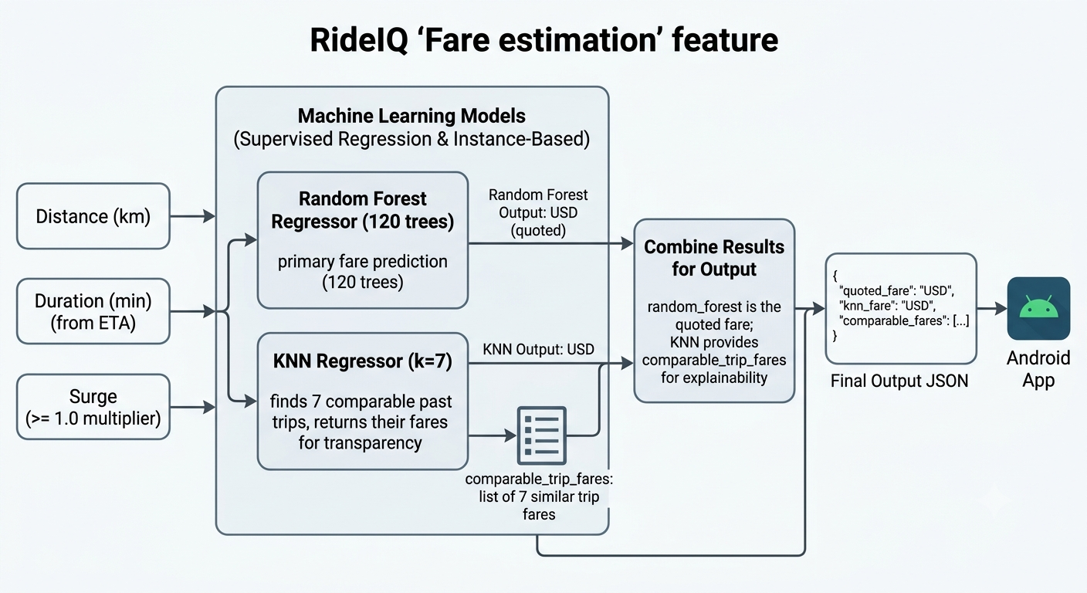
STAGE 1
The backend 'brain' - FastAPI + Python
What
A Python web service (an API) with endpoints like /quote, /route and /health. It runs the ML models and the routing engine.
Why FastAPI + Python
Python is the language of machine learning, so the models live right next to the API. FastAPI auto-builds a test page at /docs.
How it connects
This is the single source of truth. The app never does the heavy thinking - it asks the backend and shows the answer.
Two of the ML features: ETA prediction and fare estimation.
Notes:
Stage one is the brain. FastAPI + Python because that's where machine learning lives. The /docs test page is a huge productivity win.

Slide 7
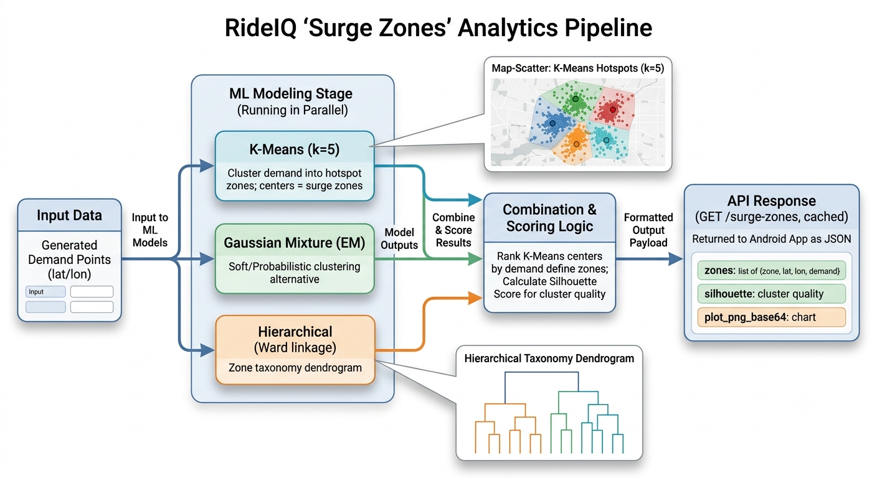
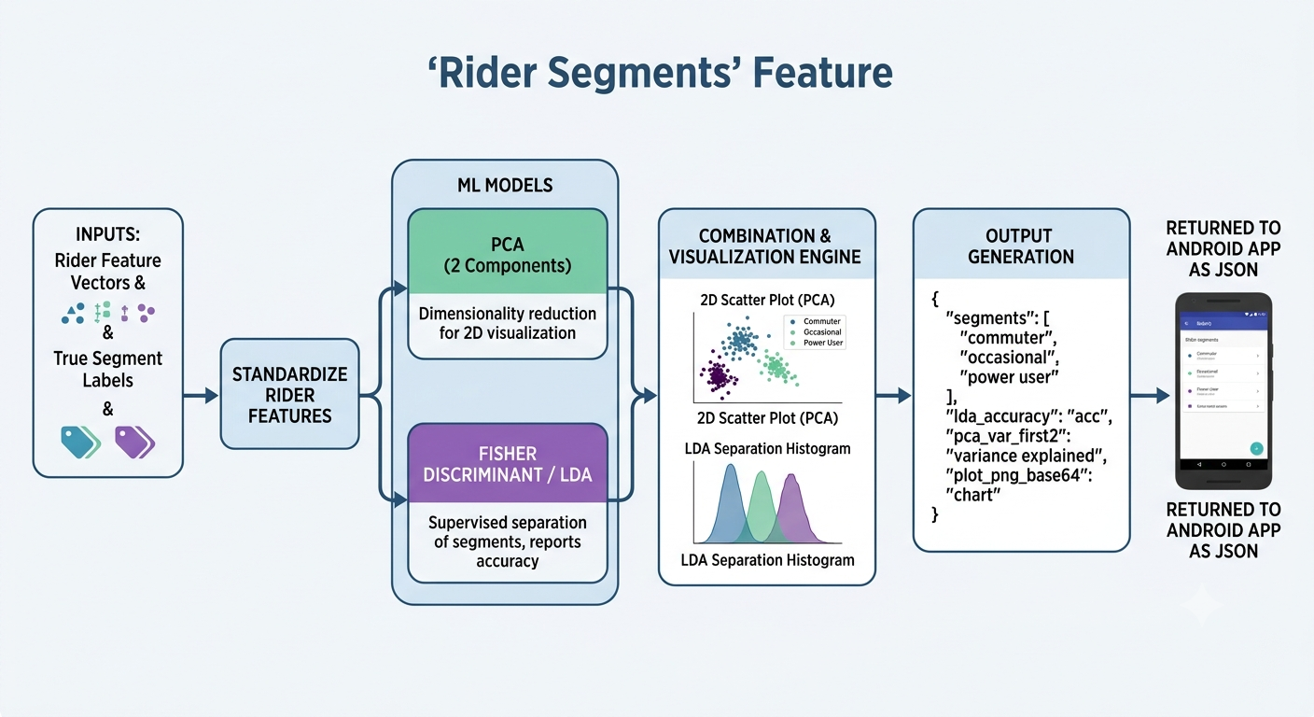
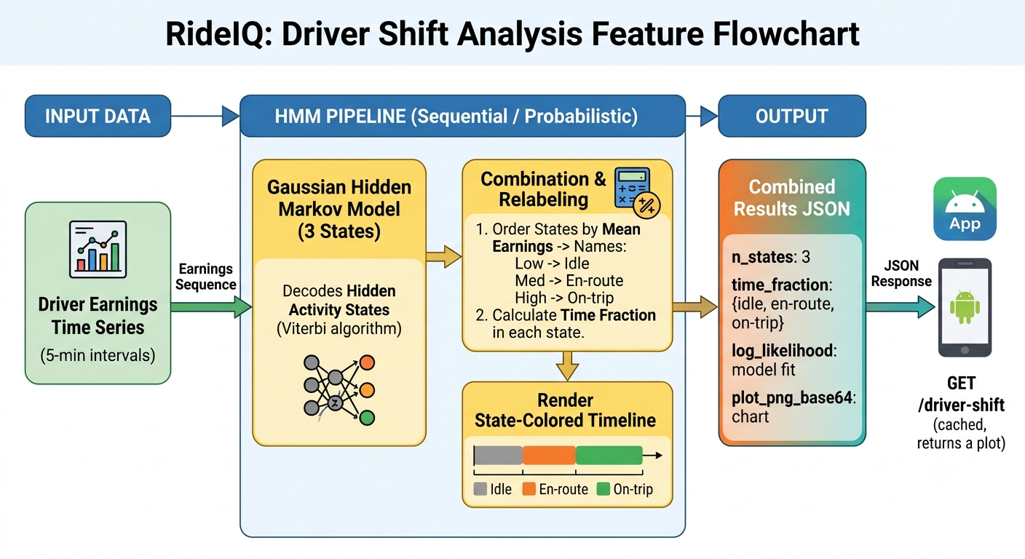
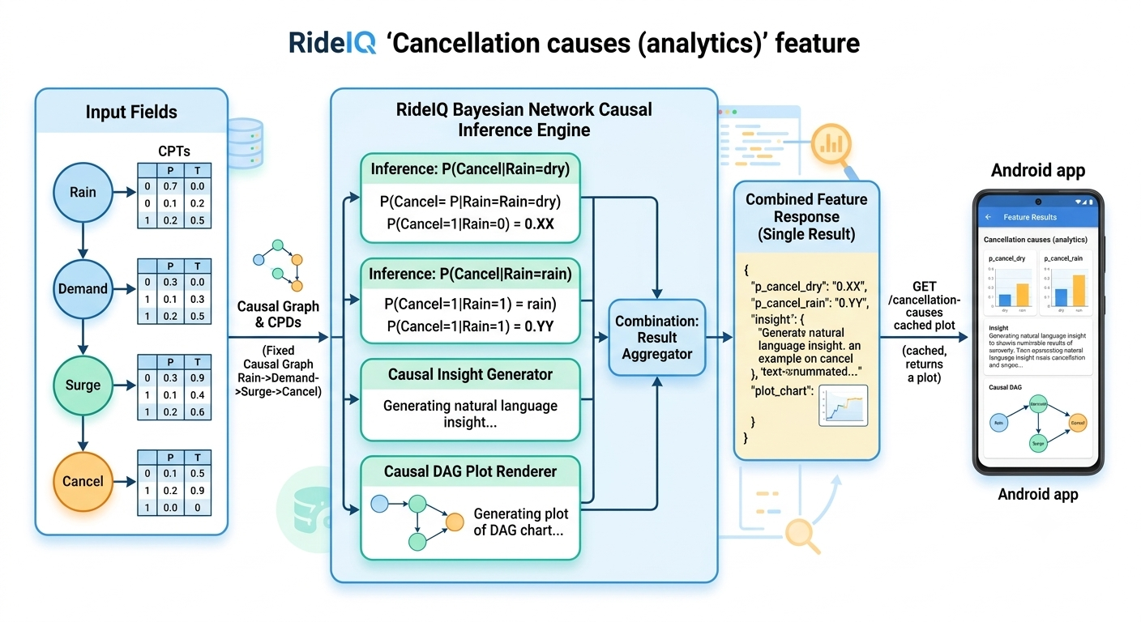
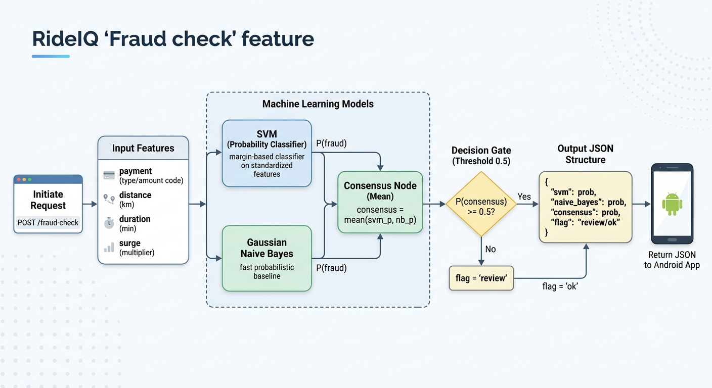
INSIDE THE BRAIN
15 ML models behind 8 real features
ETA prediction
Surge / demand zones
Rider segments
Driver shift (HMM)
Cancellation causes
Fraud check
Each feature is powered by a specific algorithm chosen for the job - regression for ETA/fare, clustering for demand, an HMM for driver states, a Bayesian network for causes. (Plus routing and the combined quote.)
Notes:
A gallery of the ML features. We won't do the math - the point is that each product feature maps to an algorithm suited to it. These diagrams were generated with Gemini Nano Banana Pro from spec files we wrote.

Slide 8
STAGE 2
Packaging with Docker - 'the app in a box'
The problem
A helpful analogy
"It works on my machine" - code that runs on your laptop breaks on the server because of different versions and settings.
Image - A sealed meal-kit with every ingredient inside.
The fix: a container
Container - The kit actually cooked and served.
A Dockerfile packs the app AND everything it needs into one image. Run the image and you get a container that behaves identically everywhere.
Registry (ghcr.io) - The shelf where meal-kits are stored and fetched.
Notes:
Docker removes the 'works on my machine' problem. Image = sealed kit, container = the cooked meal, registry = the shelf. Our pipeline builds the image and ships it to the server.

Slide 9
STAGE 3
The Android app - free maps, no API key
What
A Java app: a quote screen and a live map screen. It talks to the backend with Retrofit, which turns web responses into Java objects.
Why osmdroid
Free OpenStreetMap tiles - no Google Maps key, no billing account. Keeps the whole project self-contained.
How it connects
Every button becomes a call to a backend endpoint - 'Get quote', 'route', 'start trip'.
Edmonton's real road network, drawn from free OpenStreetMap data.
Notes:
The app is the face of the system. osmdroid gives us free maps. Retrofit is the library that makes calling the backend clean.

Slide 10
STAGE 4
Connecting the app to the backend
The bridge between the two halves of the project is literally one line:
BASE_URL = "http://<your-server>/"
1
2
3
Set it right
Set it wrong
How it travels
The app lights up with real ETAs, routes and addresses.
Every screen says 'can't reach server.'
The app sends a normal web request (HTTP) to the server's public front door.
Notes:
This single line is the bridge. It's a great teaching moment about how mobile apps reach servers over HTTP.

Slide 11
STAGE 6 · THE BIG IDEA
What is CI/CD?
Continuous Integration / Continuous Delivery. Automation that builds and ships your code every time you push it - no manual server steps, the same way every time.
1
2
3
4
Push code
->
Build image
->
Push to registry
->
Deploy to server
You commit to the main branch on GitHub.
GitHub Actions builds the Docker image in the cloud.
The image is stored on ghcr.io, tagged by commit.
It logs into EC2 over SSH and updates the live app.
The conveyor belt from your laptop to the live server - you never touch the server by hand.
Notes:
CI/CD is the conveyor belt. Push -> build -> store -> deploy, automatically. This is exactly what our GitHub Actions workflow does.

Slide 12
STAGE 7
Blue-green deployment = zero downtime
Run two copies of the app. Only one serves traffic; the other is the safety net.
1 · New version starts
2 · Health check first
The new 'color' boots up next to the live one. Users still on the old one.
We ping it: 'are you okay?' Only a healthy version is allowed to serve.
3 · Switch the front door
4 · Retire the old one
nginx flips traffic to the new color. Instant, no downtime.
The previous version steps aside - kept ready for rollback.
If the new version fails to start, traffic never switches - users notice nothing.
Notes:
Blue-green is how we get zero downtime. The health check is the key safety gate - a broken deploy simply never goes live.

Slide 13
SAFETY + FOUNDATIONS
Rollback and what system design buys us
Rollback = one-click undo
System-design pieces working for us
Every version is a tagged image. If a release misbehaves, we redeploy the previous tag. Fixing a bad deploy is as easy as making one.
nginx - Stable public front door + the traffic switch.
Redis - Caches repeated answers so the app stays fast.
Why it matters
SQLite - Stores a history of every quote.
Good system design is what lets a small team ship confidently and often - fast, safe, and reversible.
Health checks - Decide if a new version is safe before it serves.
Notes:
Rollback makes mistakes cheap. The system-design pieces - nginx, Redis, SQLite, health checks - are what make the whole thing fast, safe, and reversible.

Slide 14
STAGE 8
Growing the app, one commit at a time
1
2
3
4
My location
->
Auto addresses
->
Live navigation
->
Street names
Live GPS dot on the map (free, no Google key).
Pickup + drop-off show their real street address.
Map follows you; turns spoken + shown on screen.
'Turn left onto 109 Street' - real named directions.
Each feature was a small, self-contained change - shipped and tested through the pipeline before starting the next.
Notes:
Once the pipeline existed, features were easy and safe to add incrementally. This is the pattern that scales.

Slide 15
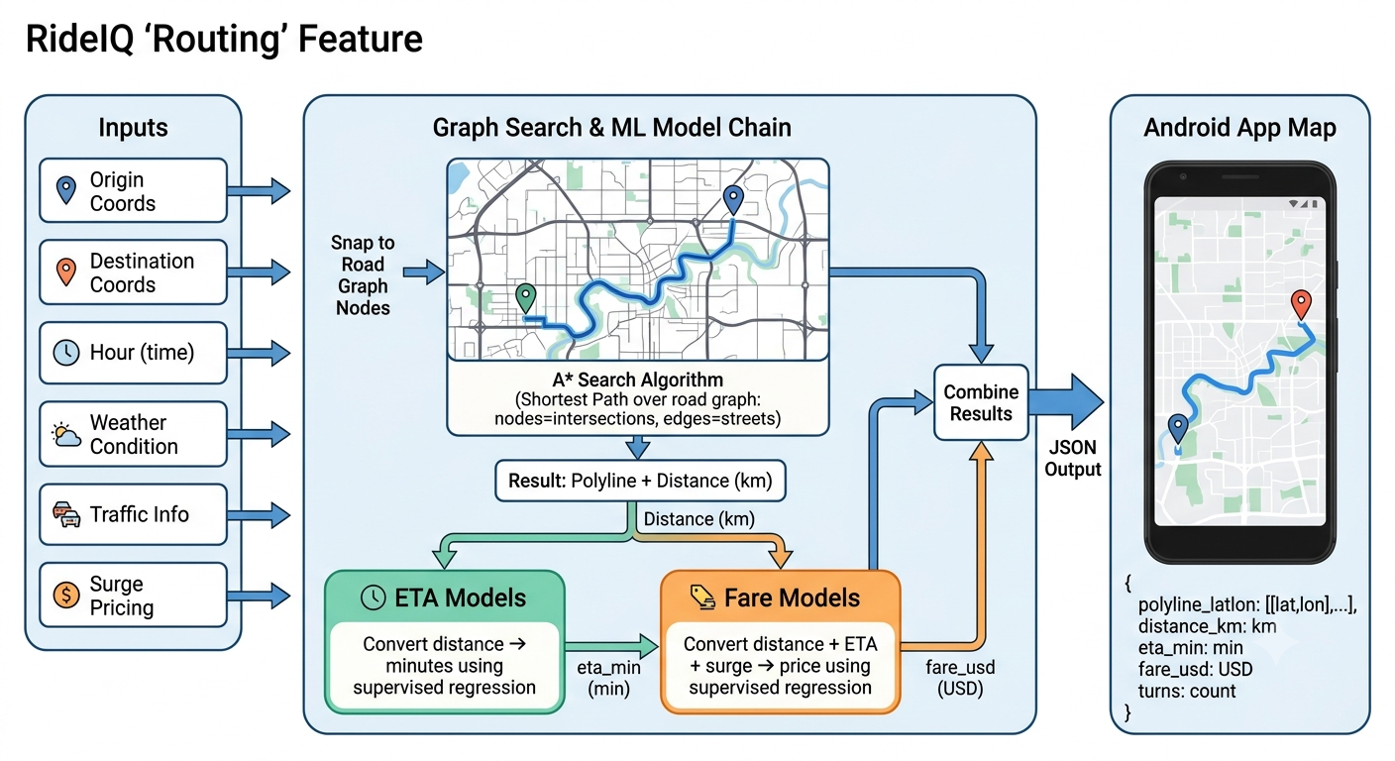
FEATURE SPOTLIGHT
How live turn-by-turn navigation works
Compute the route A* finds the road path; the backend returns each turn as a step.
1
Follow the GPS As you move, the map re-centers on your live location.
2
Speak each turn At ~200 m: 'In 200 meters, turn left onto 109 Street.' At the turn: 'Turn left now.'
3
Find the road path with A*, then price it and guide the driver.
Arrive / reroute Announces arrival; if you drift off course it reroutes automatically.
4
Notes:
The navigation feature ties GPS, the route steps, and text-to-speech together. Street names come from the OpenStreetMap graph we build.

Slide 16
DECISIONS
The technology, and why
FastAPI + Python
scikit-learn
ML lives next to the API; free auto docs.
Trains the 15 models behind every feature.
osmdroid + OSM
Docker
Free maps and routing - no Google key.
Same app everywhere; the unit we ship.
GitHub Actions
nginx
Runs the build -> push -> deploy pipeline.
Front door enabling the blue-green swap.
AWS EC2
Redis + SQLite
The cloud computer with a fixed public IP.
Speed (cache) and history (database).
Notes:
A quick reference of every major technology and the one-line reason we chose it. Theme: free, reproducible, and industry-standard.

Slide 17
RECAP
Key takeaways
1
An app and a server talk over HTTP - the app asks, the backend answers.
2
Docker boxes the app so it runs the same everywhere.
3
CI/CD turns one push into an automatic, repeatable deploy.
4
Blue-green + rollback make deploys zero-downtime and reversible.
5
Build one small thing, ship it safely, then add the next.
Notes:
If students remember five things, these are them. The last one is the meta-lesson that applies far beyond this project.

Slide 18
Thank you
RideIQ - from an idea to a live, self-deploying app.
Questions?
Notes:
Thanks! Open the floor for questions - happy to dig into any stage, the ML, or the deployment pipeline.

